Slide 1
MILITARY OPS ON VATSIM
vZJX Masterclass by Cole H.

Slide 2
Intro to Mil Procedures
Welcome Aboard!
vZJX and VATSIM are fantastic at simulating GA and Commercial flying.
We have the capability to handle both vSOA and standard military flight ops.
Unfortunately, not often trained for or practiced.
General Info
More dynamic
Adds complexity and fun
Will encourage more pilots to fly in our less used airspace

Slide 3
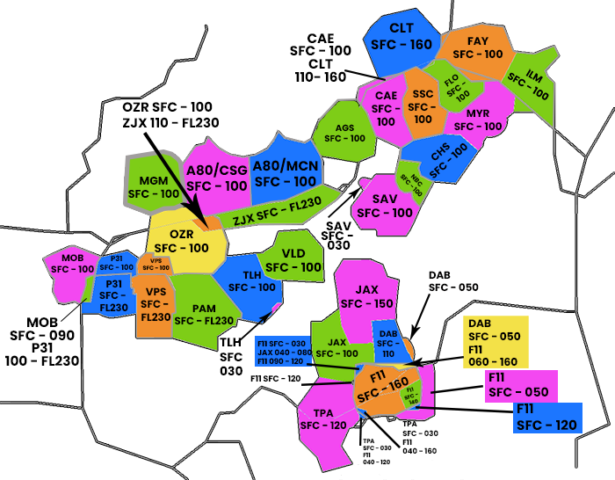
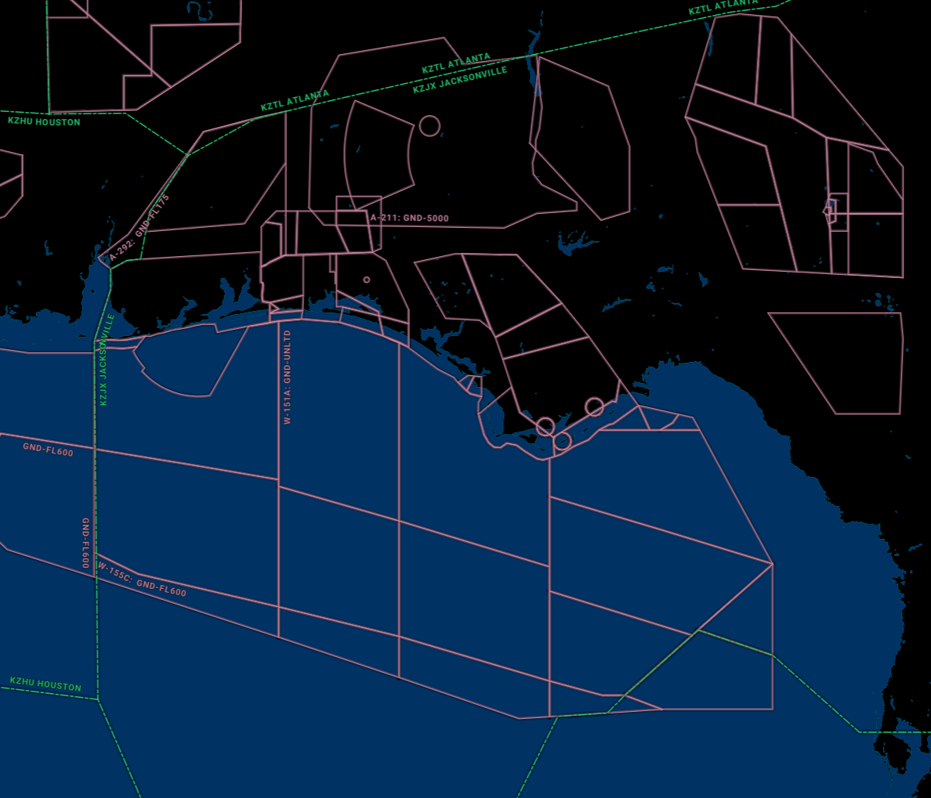
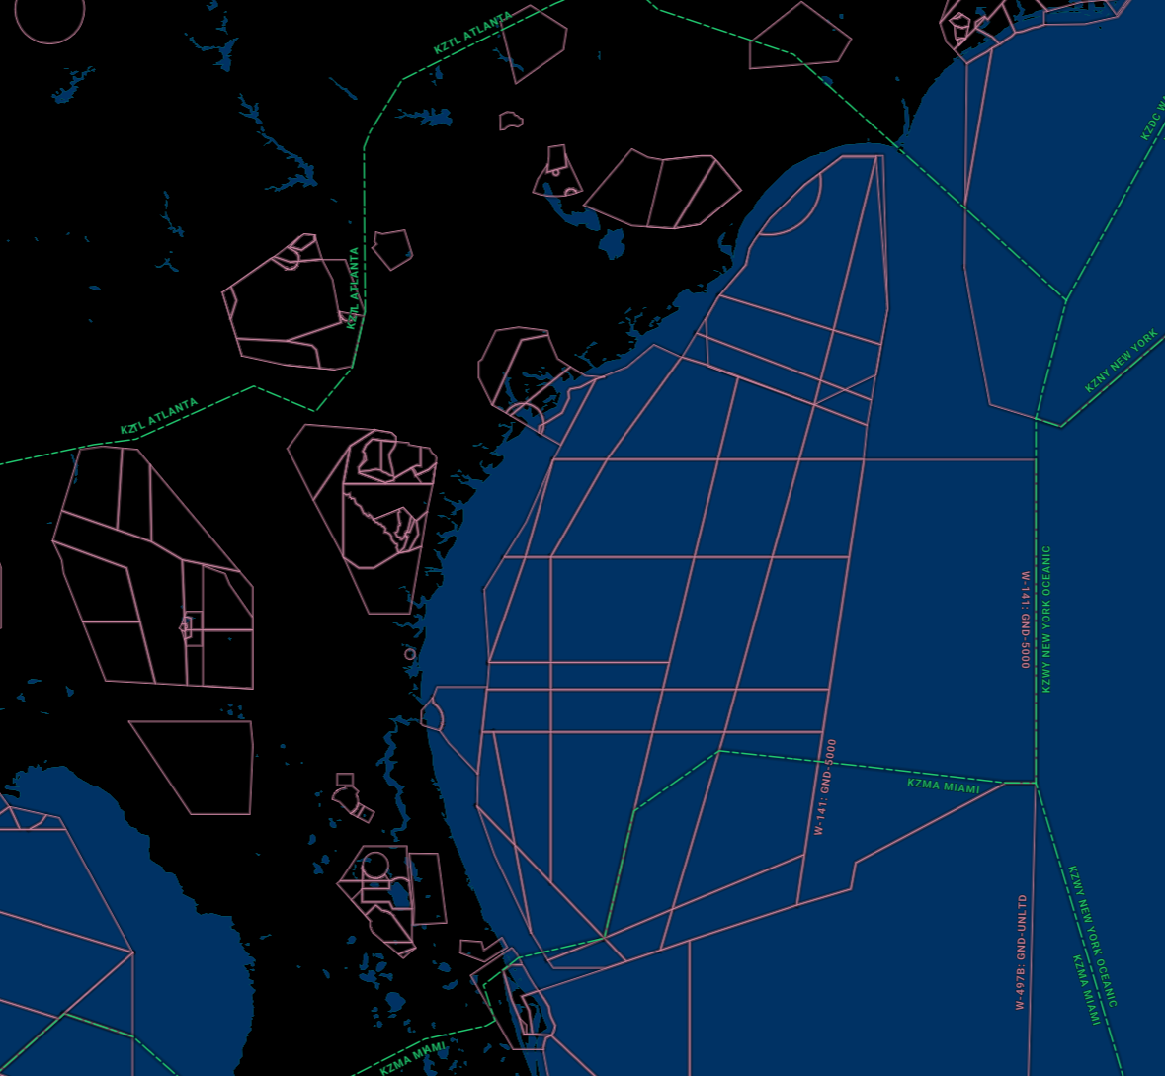
Airspaces

Slide 4
Airspace Defined
Prohibited
Security, etc. No flights permitted. e.x. P50
Restricted
Areas of hazard used by permitted aircraft. If not active, all flights allowed. If active, requires routing around. e.x. R2908
Warning
3nm off coast, activities that may contain hazards. No special routing required. e.x. W155A
Military Operations Area (MOA)
Separates training Mil aircraft from IFR traffic. If cold, no reroutes. If active, maintain separation or reroute. VFR permitted. e.x. PNMOA
Alert
Depicted areas that contain high volume of training. e.x. A292

Slide 5
Clearance Delivery
VFR: No change unless SOP VFR departure procedure exists. (NSE2V)
IFR: No change.
MOA Request: As delivery, coordinate activation with appropriate agency (approach or center based on who owns it).
Formations: Clear the flight as one aircraft unless they request separate clearances for reasons such as IFR penetration. Lead sq. mode c, wingmen standby. All flight elements receive a sq code!!! Radio callsign = “XXXX Flight” (Shooter Flight, Shooter 196 Flight)

Slide 6
Ground
Normal Taxi: Same as always
Expedited/Scramble: Taxi at pilot’s discretion, all runway crossings approved. Standard taxi phraseology may also apply as needed.
Formations: Either in-trail (centerline) or staggered taxi. Treat the formation as one aircraft, radio callsign = “XXXX Flight” (Shooter Flight, Shooter 196 Flight)

Slide 7
Tower Takeoffs
VFR: Same as always
IFR: “Cleared for takeoff, switch to departure”
Scramble: Coordinate unrestricted climbs with departure prior! “Climb unrestricted to XXXX, cleared for takeoff, switch to departure”
ALWAYS ISSUE WINDS TO MIL AIRCRAFT!!
Formations: Radio callsigns same as previously discussed
3 types of forms takeoffs:
Section: All elements roll and rotate simultaneously.
Interval: Lead rolls first, each wing waits an additional 3-5 seconds after proceeding a/c.
Individual: Treat aircraft as solo.

Slide 8
Departure Radar
Standard: No change
Scramble: Re-issue unrestricted climb instructions
Formation: Same phraseology. If section/division took off individually, until they have rejoined treat them as individuals.

Slide 9
SUA Use
SUA Request: “Center/Departure, Killer 1-1 (Flight) requests Example 1 MOA (may also ask for specific block altitudes)”
“Killer 1-1 (Flight), cleared to operate within the confines of the Example 1 MOA, maintain block altitude XXX-XXX (as required), report prior to exit, monitor this frequency for traffic advisories, frequency change approved.”
SUA Activation: “Center/Departure, Killer 1-1 (Flight) show Example 1 MOA as hot and active”
“Killer 1-1 (Flight), showing Example 1 MOA as hot and active”

Slide 10
SUA Exits
Once pilot requests exit/SUA Cold:
VFR: “Random VFR descent approved/Specific VFR instruction (as required), report clear of the MOA, Example 1 MOA cold and inactive.”
IFR: Similar to pop-up IFR!
“Cleared to XXX…. (full clearance), Example 1 MOA cold and inactive.”

Slide 11
SUA Traffic Management
Unauthorized/VFR Target Entry:
“Killer 1-1, Whiskey Alert/Interloper, Bearing XXX, Range XXnm, Altitude XXX”
If target leaves:
“Killer 1-1, Spill Out.”

Slide 12
Airborne Intercepts
Congratulations, as ATC you are the Air Battle Manager! (E2/E3 radar operator).
Vectoring to TOI (Target of Interest)
“Killer 1-1, cleared into Class A airspace with due regard”
May also issue headings and altitudes.
Pilot may request a BRA or a Bogey Dope
BRA = Bearing, Range, Altitude. Bearing to intercept, range to intercept, altitude of TOI.
Bogey dope is pilot phraseology requesting a BRA.

Slide 13
IFR Arrivals
Nothing different! Continue to treat forms flights as a single aircraft unless they request separate IFR handling.

Slide 14
Breaks
Pilot requests break
“Killer 1-1, proceed to X mile initial, (turn direction as required) report initial”
After reporting initial: “Killer 1-1, break (at the numbers/midfield/upwind) approved, report the break.”
Reporting break: “Killer 1-1, winds xxx/xx, check gear down, runway xx cleared to land/t+g” etc.
Types of break:
Interval break: Lead breaks first, wing waits 3-5 seconds then follows.
Section/Fan: Lead and wing break 2 seconds apart, varying AoB and pull to maintain separation.
Carrier: 800ft AGL initial, followed by a short fan break to land.

Slide 15
Landing Pattern Tips
PILOT REPORTS GEAR DOWN EACH PASS!
Always issue winds to the pilot on each pass as well!
https://www.youtube.com/watch?v=fduiDD3VxCU

